Slide 1

UNIVERSITY OF RWANDA
MUSANZE CAMPUS
MODULE : WEB SECURITY
DATE : 20/10/2022
ASSIGNMENT 1
Reg no: 220006210
Names:ISHIMWE Regis
TOPIC : HOW WEB SERVER WORKS

Slide 2
HOW WEB SERVERS WORK
definition, a web server is a computer program that sends back HTML pages in response to HTTP requests. When a browser makes an HTTP request, modern web servers allow code to be executed in order to generate the web page HTML dynamically, and often incorporate content from a database.

Slide 3
how web server works cont’
At the most basic level, whenever a browser needs a file that is hosted on a web server, the browser requests the file via HTTP. When the request reaches the correct (hardware) web server, the (software) HTTP server accepts the request, finds the requested document, and sends it back to the browser, also through HTTP. (If the server doesn't find the requested document, it returns a 404 response instead.)

Slide 4
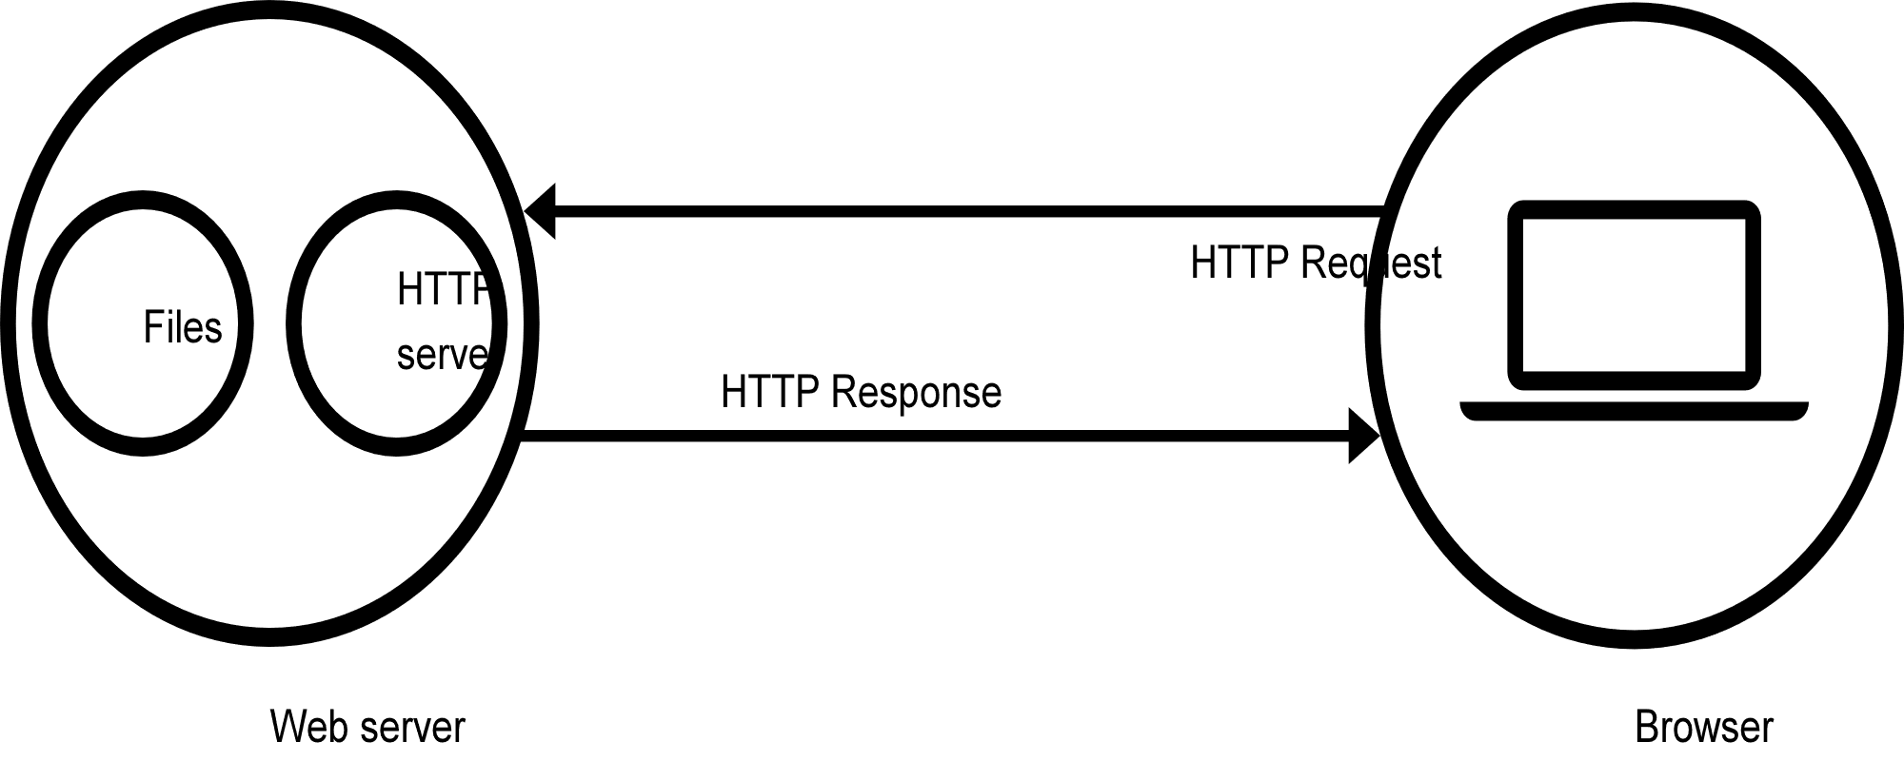
diagram

Slide 5
Web servers serve two types of content in response to HTTP requests
static resources is an HTML file, image file, or other type of file that the web server returns unaltered in HTTP responses
dynamic resources is code, a script, or a template that the web server executes or interprets in response to an HTTP request.
Modern web servers are capable of hosting both static and dynamic resources.

Slide 6
Static resources
In the early days of the internet, websites consisted mostly of static resources. Developers coded HTML files by hand, and websites consisted of individual HTML files that were deployed to the web server.
The “deployment” of a website required the developer to copy all the HTML files to the web server and restart the server process. When a user wished to visit the website, they would type the website’s URL in their browser. The browser would make an HTTP
request to the web server hosting the website, which would interpret the incoming URL as a request for a file on disk.Finally, the web server would return the HTML file as is in the HTTP response.
html suffix, indicating that each web page corresponds to an HTML file on the server.

Slide 7
Dynamic Resources
Most modern websites instead use dynamic resources. Often the dynamic resource’s code loads data from a database in order to populate the HTTP response. Typically, the dynamic resource outputs HTML, though other con_x0002_tent types can be returned depending on the expectations of the browser.Dynamic resources allow retail websites to implement a single product web page capable of displaying many types of products.
There are many other uses for dynamic resources. If you access your banking website, it looks up your account details and incorporates them in the HTML. A search engine like Google returns matches pulled from Google’s massive search index and returns them in a dynamic page. Many sites, including social media and web-mail sites, look different to each user, because they dynamically construct the HTML after the user logs in.

Slide 8
THANK YOU !!

